Slide 1
C++ is Fun – Part 13 at Turbine/Warner Bros.!
Russell Hanson

Slide 2
Syllabus
1) First program and introduction to data types and control structures with applications for games learning how to use the programming environment Mar 25-27
2) Objects, encapsulation, abstract data types, data protection and scope April 1-3
3) Basic data structures and how to use them, opening files and performing operations on files – April 8-10
4) Algorithms on data structures, algorithms for specific tasks, simple AI and planning type algorithms, game AI algorithms April 15-17
Project 1 Due – April 17
5) More AI: search, heuristics, optimization, decision trees, supervised/unsupervised learning – April 22-24
6) Game API and/or event-oriented programming, model view controller, map reduce filter – April 29, May 1
7) Basic threads models and some simple databases SQLite May 6-8
8) Graphics programming, shaders, textures, 3D models and rotations May 13-15
Project 2 Due May 15
9) How to download an API and learn how to use functions in that API, Windows Foundation Classes May 20-22
10) Designing and implementing a simple game in C++ May 27-29
11) Selected topics – Gesture recognition & depth controllers like the Microsoft Kinect, Network Programming & TCP/IP, OSC June 3-5
12) Working on student projects - June 10-12
Final project presentations Project 3/Final Project Due June 12

Slide 3
Recall, Project 2 due next Wednesday ☺

Slide 4
Today is LAB DAY, time to get familiar with OpenGL and GLUT (because PowerPoint is boring)
Goals of LAB DAY:
  Get comfortable with 3D graphics
  Show off new GLUT/OpenGL/DirectX stuff
  Make pretty pictures
  Change lighting on pretty pictures
  Change viewport, etc. for pretty pictures
  Make 3D stuff on the computer
  Understand what’s happening with everything

Slide 5
Installing FreeGLUT/GLUT on Visual Studio 2010:
http://visualambition.wordpress.com/2010/08/12/glut-and-visual-studio-2010/
Install directions for Xcode:
Step by Step: Xcode 4, OpenGL & GLUT in Lion
http://www.autofasurer.net/wp/?p=106

Slide 6
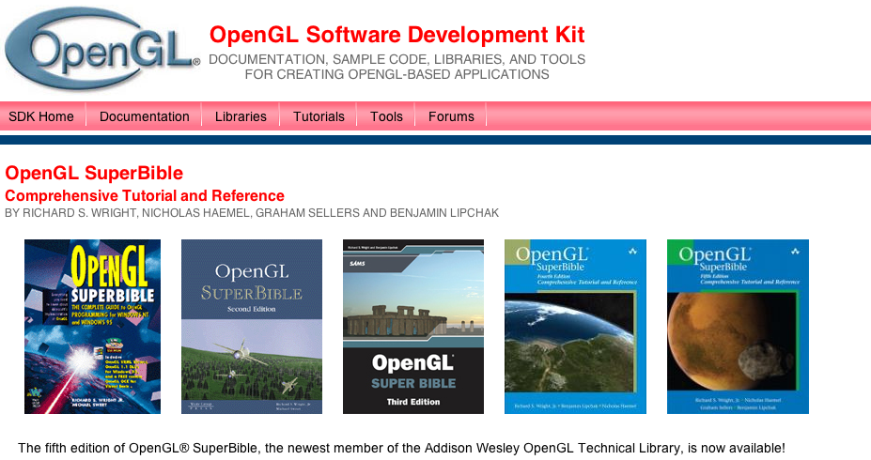
http://www.opengl.org/sdk/docs/books/SuperBible/
Sample Code From Fourth Edition
Complete source code for all platforms (182 MB): SB-AllSource.zip
Source with pre-built binaries (Windows, 120MB): SB-WinwBin.zip
Source with pre-built binaries (Mac OS X, 208MB): SB-MacwBin.zip
Source only, no binaries (Windows, 60MB): SB-WinSrc.zip
Source only, no binaries (Mac OS X, 71MB): SB-MacSrc.zip
Source only, no binaries (Linux, 48MB): SB-LinuxSrc.tar.bz2

Slide 7
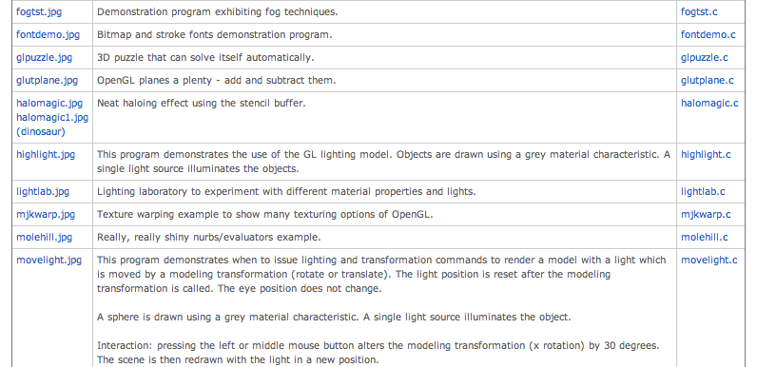
http://www.sgi.com/products/software/opengl/examples/glut/examples/

Slide 8
whiterect

Slide 9
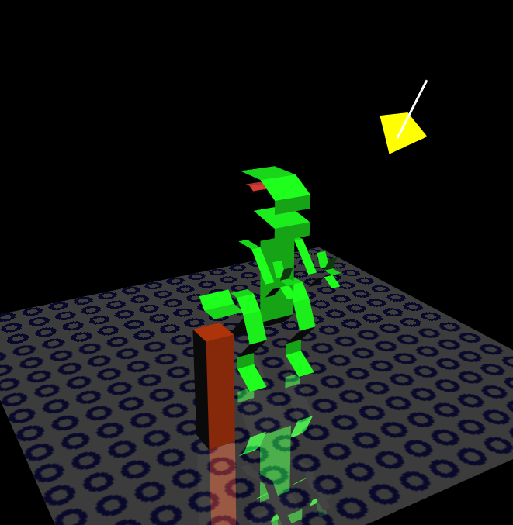
halomagic

Slide 10
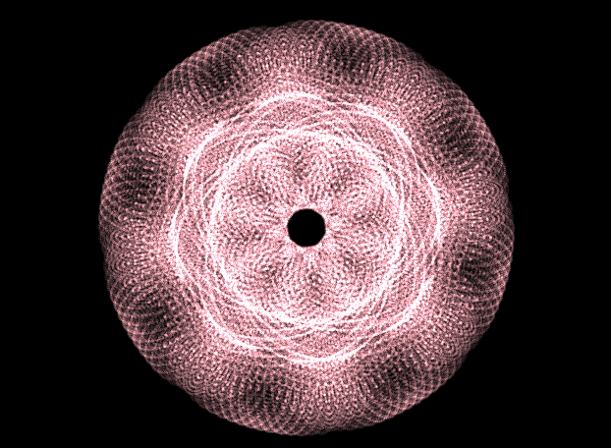
harmonograph

Slide 11
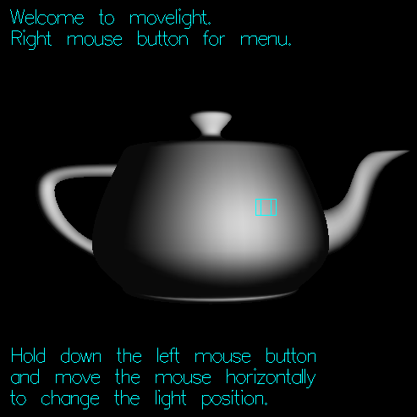
movelight

Slide 12
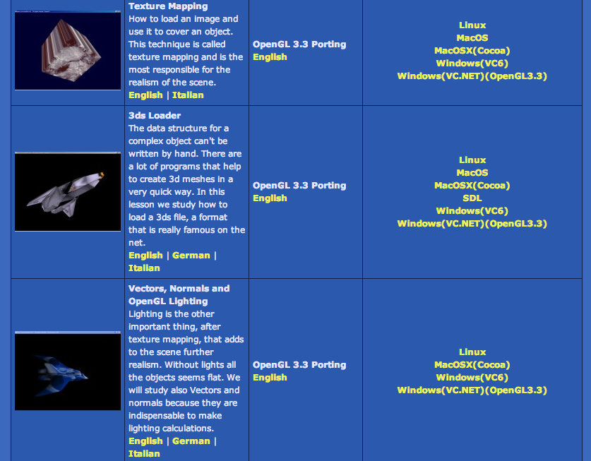
http://www.spacesimulator.net/wiki/index.php?title=3d_Engine_Programming_Tutorials

Slide 14
Double Buffering

Slide 17
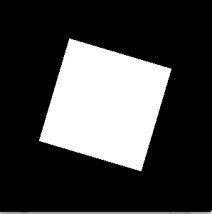
doublebuffer spinning rectangle

Slide 18
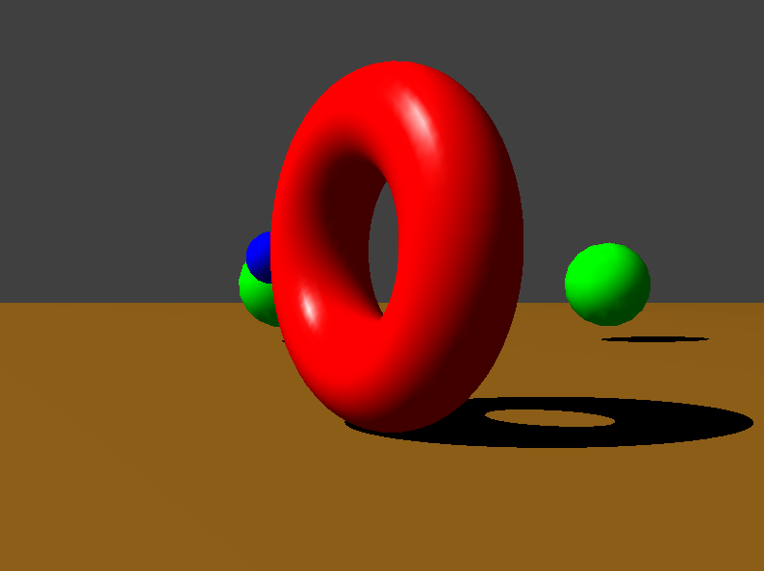
sphereworld

Slide 19
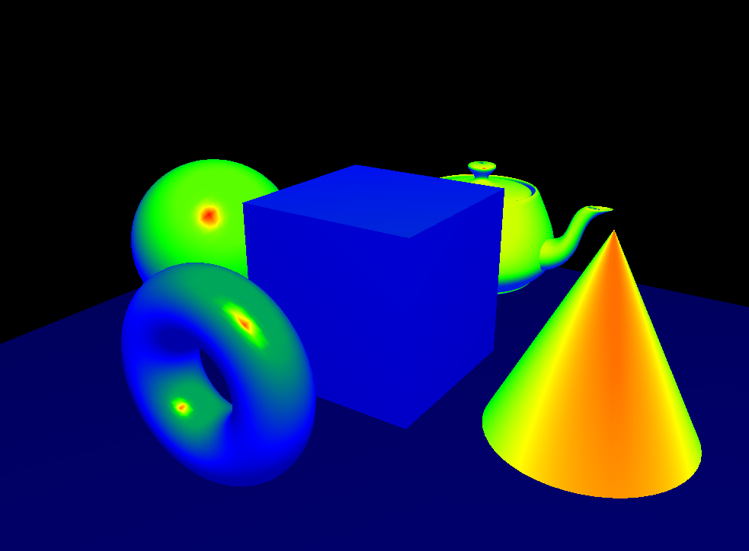
fragmentshaders.cpp

Slide 20
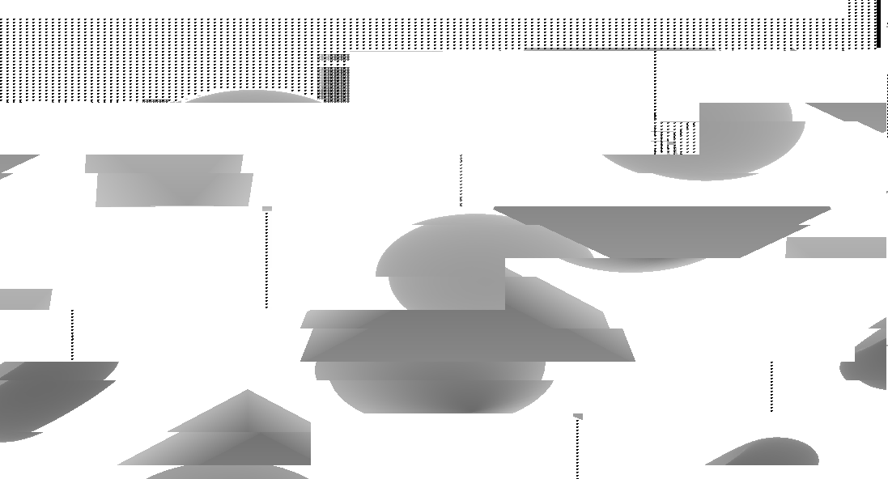
shadowmap

